Slide 1
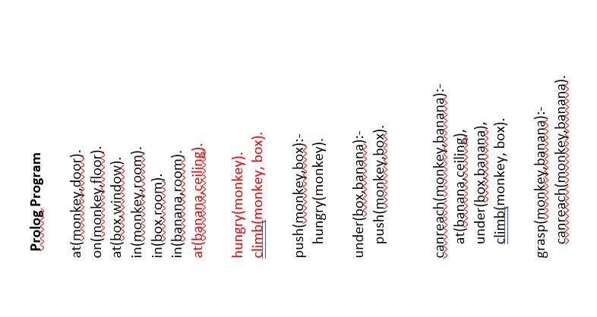

Slide 2
def clean(floor):
i, j, row, col = 0, 0, len(floor), len(floor[0])
for i in range(row):
if(i%2 == 0):
for j in range(col):
if(floor[i][j] == 1):
print(floor, i, j)
floor(floor, i, j)
else:
for j in range(col-1, -1, -1):
if(floor[i][j] == 1):
print(floor, i, j)
floor[i][j] = 0
print(floor, i, j)
def print(floor, row, col):
"""A function to print the GRID , (row, col) represent the current vacuum cleaner position"""
print("The Floor matrix is as below:")
for r in range(len(floor)):
for c in range(len(floor[r])):
if r == row and c == col:
print(f" >{floor[r][c]}< ", end = '')
else:
print(f" {floor[r][c]} ", end = '')
print(end = '\n')
print(end = '\n')
def main():
floor = []
m = int(input("Enter the No. of Rows: "))
n = int(input("Enter the No. of Columns: "))
print("Enter clean status for each cell (1 - dirty, 0 - clean)")
for i in range(m):
f = list(map(int, input().split(" ")))
floor.append(f)
print()
clean(floor)

Slide 3
1. Prolog - Facts and rules makes up the knowledge base.
-- facts
-- rules
2. syntax
if :-
and ,
or ;
not not
3. variables always start with capital letters or underscore.
4. fatty(Johnie).
johnie is fatty
dog(brown).
dog is brown
friends(johnie,alex).
johnie and alex are friends.
you put a fullstop at the end of every statement.
5. Facts:
likes(dan,sally).
dan likes sally.
likes(sally,dan).
sally likes dan.
likes(josh,brittney).
josh likes brittney.
Rules:
There exists a friendship between X and Y, if X likes Y and Y likes X.
friendship(X,Y):-likes(X,Y),likes(Y,X).
Execution:
likes(dan,sally).
true
friendship(dan,sally).
true
friendship(josh,sally).
false
friendship (josh,britteny).
true
MONKEY AND BANANA

Slide 4
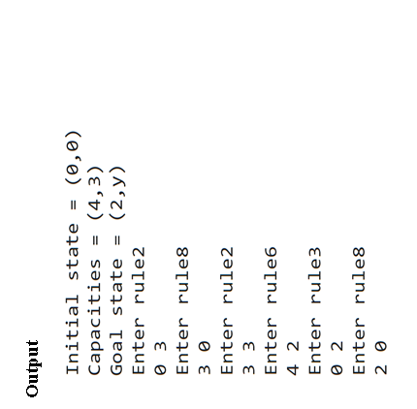
WATER JUG
x = 0
y = 0
m = 4
n = 3
print("Initial state = (0,0)")
print("Capacities = (4,3)")
print("Goal state = (2,y)")
while x != 2:
r = int(input("Enter rule"))
if(r == 1):
x = m
elif(r == 2):
y = n
elif(r == 3):
x = 0
elif(r == 4):
y = 0
elif(r == 5):
t = n - y
y = n
x -= t
elif(r == 6):
t = m - x
x = m
y -= t
elif(r == 7):
y += x
x = 0
elif(r == 8):
x += y
y = 0
print (x,y)

Slide 5
8-PUZZLE
class Solution:
def solve(self, board):
dict = {}
flatten = []
for i in range(len(board)):
flatten += board[i]
flatten = tuple(flatten)
dict[flatten] = 0
if flatten == (0, 1, 2, 3, 4, 5, 6, 7, 8):
return 0
return self.get_paths(dict)
def get_paths(self, dict):
cnt = 0
while True:
current_nodes = [x for x in dict if dict[x] == cnt]
if len(current_nodes) == 0:
return -1
for node in current_nodes:
next_moves = self.find_next(node)
for move in next_moves:
if move not in dict:
dict[move] = cnt + 1
if move == (0, 1, 2, 3, 4, 5, 6, 7, 8):
return cnt + 1
cnt += 1

Slide 6
def find_next(self, node):
moves = {
0: [1, 3],
1: [0, 2, 4],
2: [1, 5],
3: [0, 4, 6],
4: [1, 3, 5, 7],
5: [2, 4, 8],
6: [3, 7],
7: [4, 6, 8],
8: [5, 7],
}
results = []
pos_0 = node.index(0)
for move in moves[pos_0]:
new_node = list(node)
new_node[move], new_node[pos_0] = new_node[pos_0], new_node[move]
results.append(tuple(new_node))
return results
ob = Solution()
matrix = [
[3, 1, 2],
[4, 7, 5],
[6, 8, 0]
]
print(ob.solve(matrix))
8-PUZZLE

Slide 7
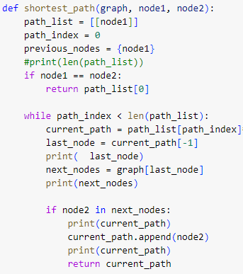
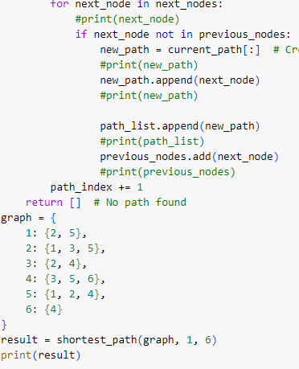
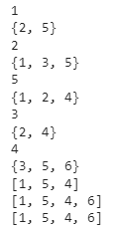
BFS
OUTPUT

